Slide 1
Audit of CBD use and monitoring
in the East Anglia
Dr Mbah Ebubechukwu
Dr Gautam Ambegaonkar
EPEN Meeting
14th October 2021

Slide 2
Introduction
In June 2018, the Home Office launched a review into the scheduling of cannabis and cannabis based products for medicinal purposes
The British Paediatric Neurology Association (BPNA) was tasked to develop interim clinical guidance for clinicians for prescription of cannabis- based products for medicinal use in children and young people with epilepsy and for monitoring blood tests when on EpidiolexTM
Since release of these guidelines, there has been no review on how it is followed in the East of England.

Slide 3
Objectives
To assess adherence to guidelines in East Anglia
To assess compliance, tolerability and review side effects on CBD
Secondary objectives
To check if children on CBD have named consultant/ nurse
To identify delay in getting repeat prescriptions
To check for monitoring when on CBD

Slide 4
Monitoring guidelines on CBD
Routine blood monitoring schedule
Pre-treatment
Test 1 Month 1
Test 2 Month 3
Test 3 Month 6
Test 4 Ongoing, As clinically indicated (not routine)
Upon increasing Epidiolex dose above 10 mg/kg/day or changes in medicinal products - schedule should be restarted.
Patients with identified baseline elevations of ALT or AST and patients who are taking valproate are recommended to undergo intensified monitoring (next page)

Slide 5
Intensified monitoring schedule
Test 1 2 weeks (additional)
Test 2 Month 1
Test 3 Month 2 (additional)
Test 4 Month 3
Test 5 Month 6
Test 6 Ongoing, As clinically indicated
Discontinue CBD if ALT > 3 upper limit of normal

Slide 6
Methods
Details of all children on Epidiolex maintained on a database at CUHFT
Retrospective data collection using EPIC
Local hospital contacted for missing information

Slide 7
Results
28 children on Epidiolex in East Anglia between 2018 - 2021
Duration of being on Epidiolex between 2 weeks – 2 ½ yrs.

Slide 8
Which hospital/ region?

Slide 9
Named professional
All children had a named consultant
Not all had a named epilepsy nurse specialist identifiable

Slide 10
Indication for starting Epidiolex

Slide 11
AEDs in addition to CBD
Clobazam (92%)
Sodium Valproate
Keppra
Topiramate
Stiripentol
Lamotrigine
Rufinamide

Slide 12
Monitoring whilst on CBD

Slide 13
Pre-treatment blood tests
Done in all 28 patients
Results
25 Normal
3 Abnormal (deranged LFT)

Slide 14
Subsequent tests (Month 1, 3, 6)
Children who were on Epidiolex for less than 1 month – excluded

Slide 15
Blood tests whilst on CBD

Slide 16
Other side effects on Epidiolex
Loss of appetite
Weakness
Weight loss
Agitation/restlessness
Nausea and vomiting

Slide 17
Repeat Prescriptions
n = 5 initial prescription
n = 16 on time
n = 7 delay in getting repeat prescription

Slide 18
Summary / Conclusions
Standard | Target compliance | Fraction | Percentage compliance %
Standard 1:Diagnosis for starting Epidiolex (LGS, Dravet, Atypical) | 100% | 28/28 | 100%
Standard 2: Are all children on Clobazam before Epidiolex | 100% | 26/28 | 92%
Standard 3: Do all children have name doctor/ nurse | 100% | 28/28 26/28 | 100% doctor 92% nurse
Standard 4:Blood test prior to commencement | 100% | 28/28 | 100%
Standard 5:Blood test at correct intervals according to guidelines | 100% | 16/28 | 57%

Slide 19
Recommendations
Ensure named nurse recorded on records
Improve recording of blood tests whilst on Epidiolex + better recording of tests
Establish a pathway for repeat prescription to minimise delay via secretaries / nurses (for discussion)
Create a central folder for children whilst on Epidiolex?

Slide 20
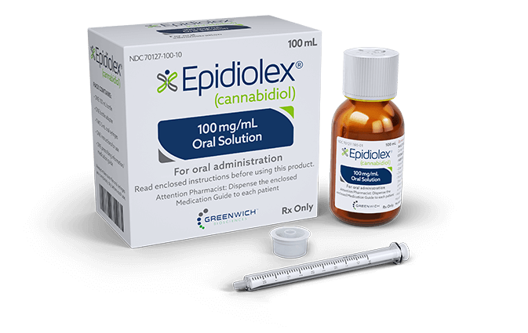
Thank You
Any Questions?

