Slide 1
IVIG in refractory epilepsy Is there an emerging evidence?
Dr Tekki Rao
Luton
EPEN – 14.10.21

Slide 2
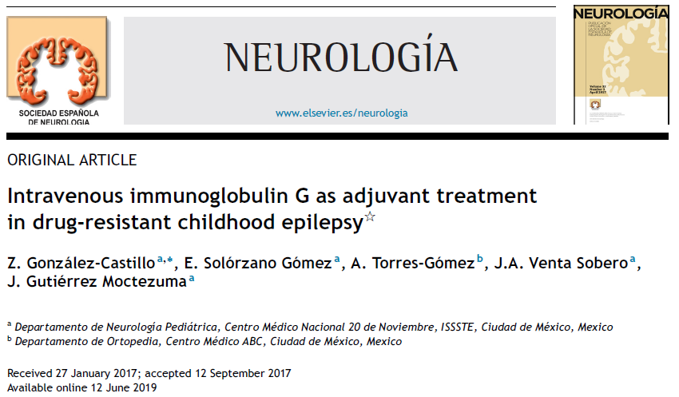

Slide 3
Study
Analytical, Observational, Case-control
Institute: Mexico City Hospital
Period: 2003 – 2013
Subjects: children(<18) with drug resistant epilepsy (ILAE definition)
Method: IVIg 0.4g/kg/day x 5 in each cycle x 6; 3 week interval between cycles
Analysis: Simple statistical methods

Slide 4
Data
856 children with epilepsy
167 with DRE (19.5%)
44 Rx with IVIg
38 included (Complete Rx); M:F=26:12
Mean age
Onset: 2 yrs
IVIg: 6.12

Slide 5
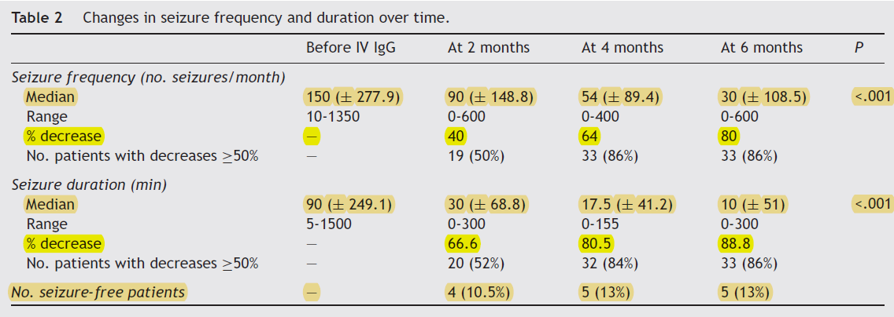
Results
No of AED before Rx: 2.65; after Rx: 2.84
Epilepsy Surgery: 5 pts (13%); 3VNS, 2 Corpus callosotomy

Slide 6
Discussion on paper
Variable response in different papers (15-86%)
Cochrane review 2017:
1 placebo controlled RCT includes adults
IVIg 52.5% response ; placebo 27.8% (p=0.095)
Limitations
Observational retrospective
Pt as own control
No randomisation
Information from records
Conclusion: IVIg can used as an adjuvant

Slide 7
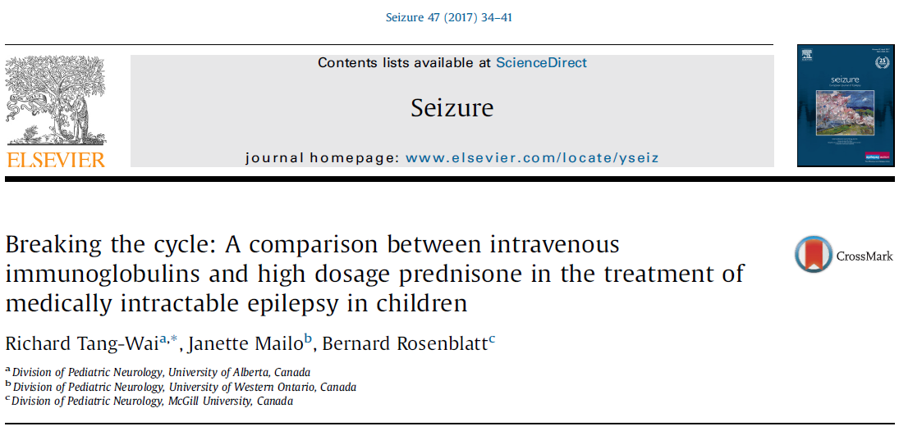
Steroid vs IVIg

Slide 8
Study
Single centre (Canada), retrospective observational
Subjects: Children<17 years with DRE
Period: 2005-16
Exclusions: Infantile spasms & Autoimmune
Method: IVIg – 1g/kg monthly or Prednisolone 1-2mg/kg/day for 2 weeks then taper 4-6 weeks; repeated steroids or crossover

Slide 9
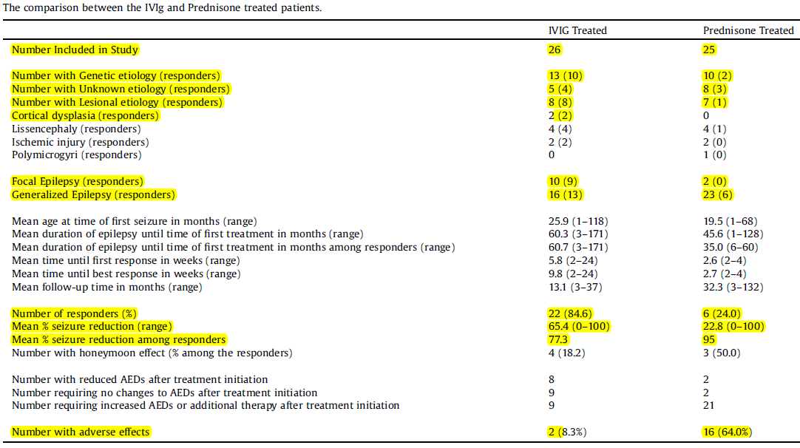

Slide 10
Discussion 2
IVIg group
Number : 26
Age: 2-13 yrs
Cross over: 1
Response: 22/26 (84.6%)
Sz reduction : 0-100%
Mean response time: 5.9wks
Relapse: Low
Steroid group
25
1.5-10
10
6/25 (24%)
70-100%
2.7 wks
High

Slide 11
Discussion
Mechanisms: Unknown, but possible membrane stabilising and gene transcription in steroids but temporary
Pathway that leads to refractoriness is reversible and immune mediated hence response to IVIg
Discrepant response on patients with same etiology in steroid group but consistent in IVIg
Response in IVIg is etiology independent, delayed but sustained in IVIg than steroids
IVIg should be considered early in epilepsy than when intractability persisted.

Slide 12
Food for thought!
Neuroinflammation – has a role in intractability
Steroids vs IVIg: IVIg appears superior
Anyone in region or nationally used IVIg?
Cost implications? Vs Saving on admissions?
Can we consider – regional guidance?
What dose and protocol?

Slide 13
References
Tang-Wai, R., Mailo, J., & Rosenblatt, B. (2017). Breaking the cycle: A comparison between intravenous immunoglobulins and high dosage prednisone in the treatment of medically intractable epilepsy in children. Seizure, 47, 34-41.
González-Castillo, Z., Gómez, E. S., Torres-Gómez, A., Sobero, J. V., & Moctezuma, J. G. (2020). Intravenous immunoglobulin G as adjuvant treatment in drug-resistant childhood epilepsy. Neurología (English Edition), 35(6), 395-399.
Geng J, Dong J, Li Y, Ni H, Jiang K, Shi LL, et al. Intravenousimmunoglobulins for epilepsy. Cochrane Database Syst Rev.2017, http://dx.doi.org/10.1002/14651858.CD008557.pub3.CD008557 [review].

