Slide 1
MECP2-related and CDKL5 deficiency cases in the EoE region
Dr Asma Soltani, MRCPCH, PhD
RCPCH Clinical Research Fellow
ST4 Paediatric Trainee
Dr Lipi Shekhar, MRCPCH,MD
ST5 Paediatric trainee

Slide 2
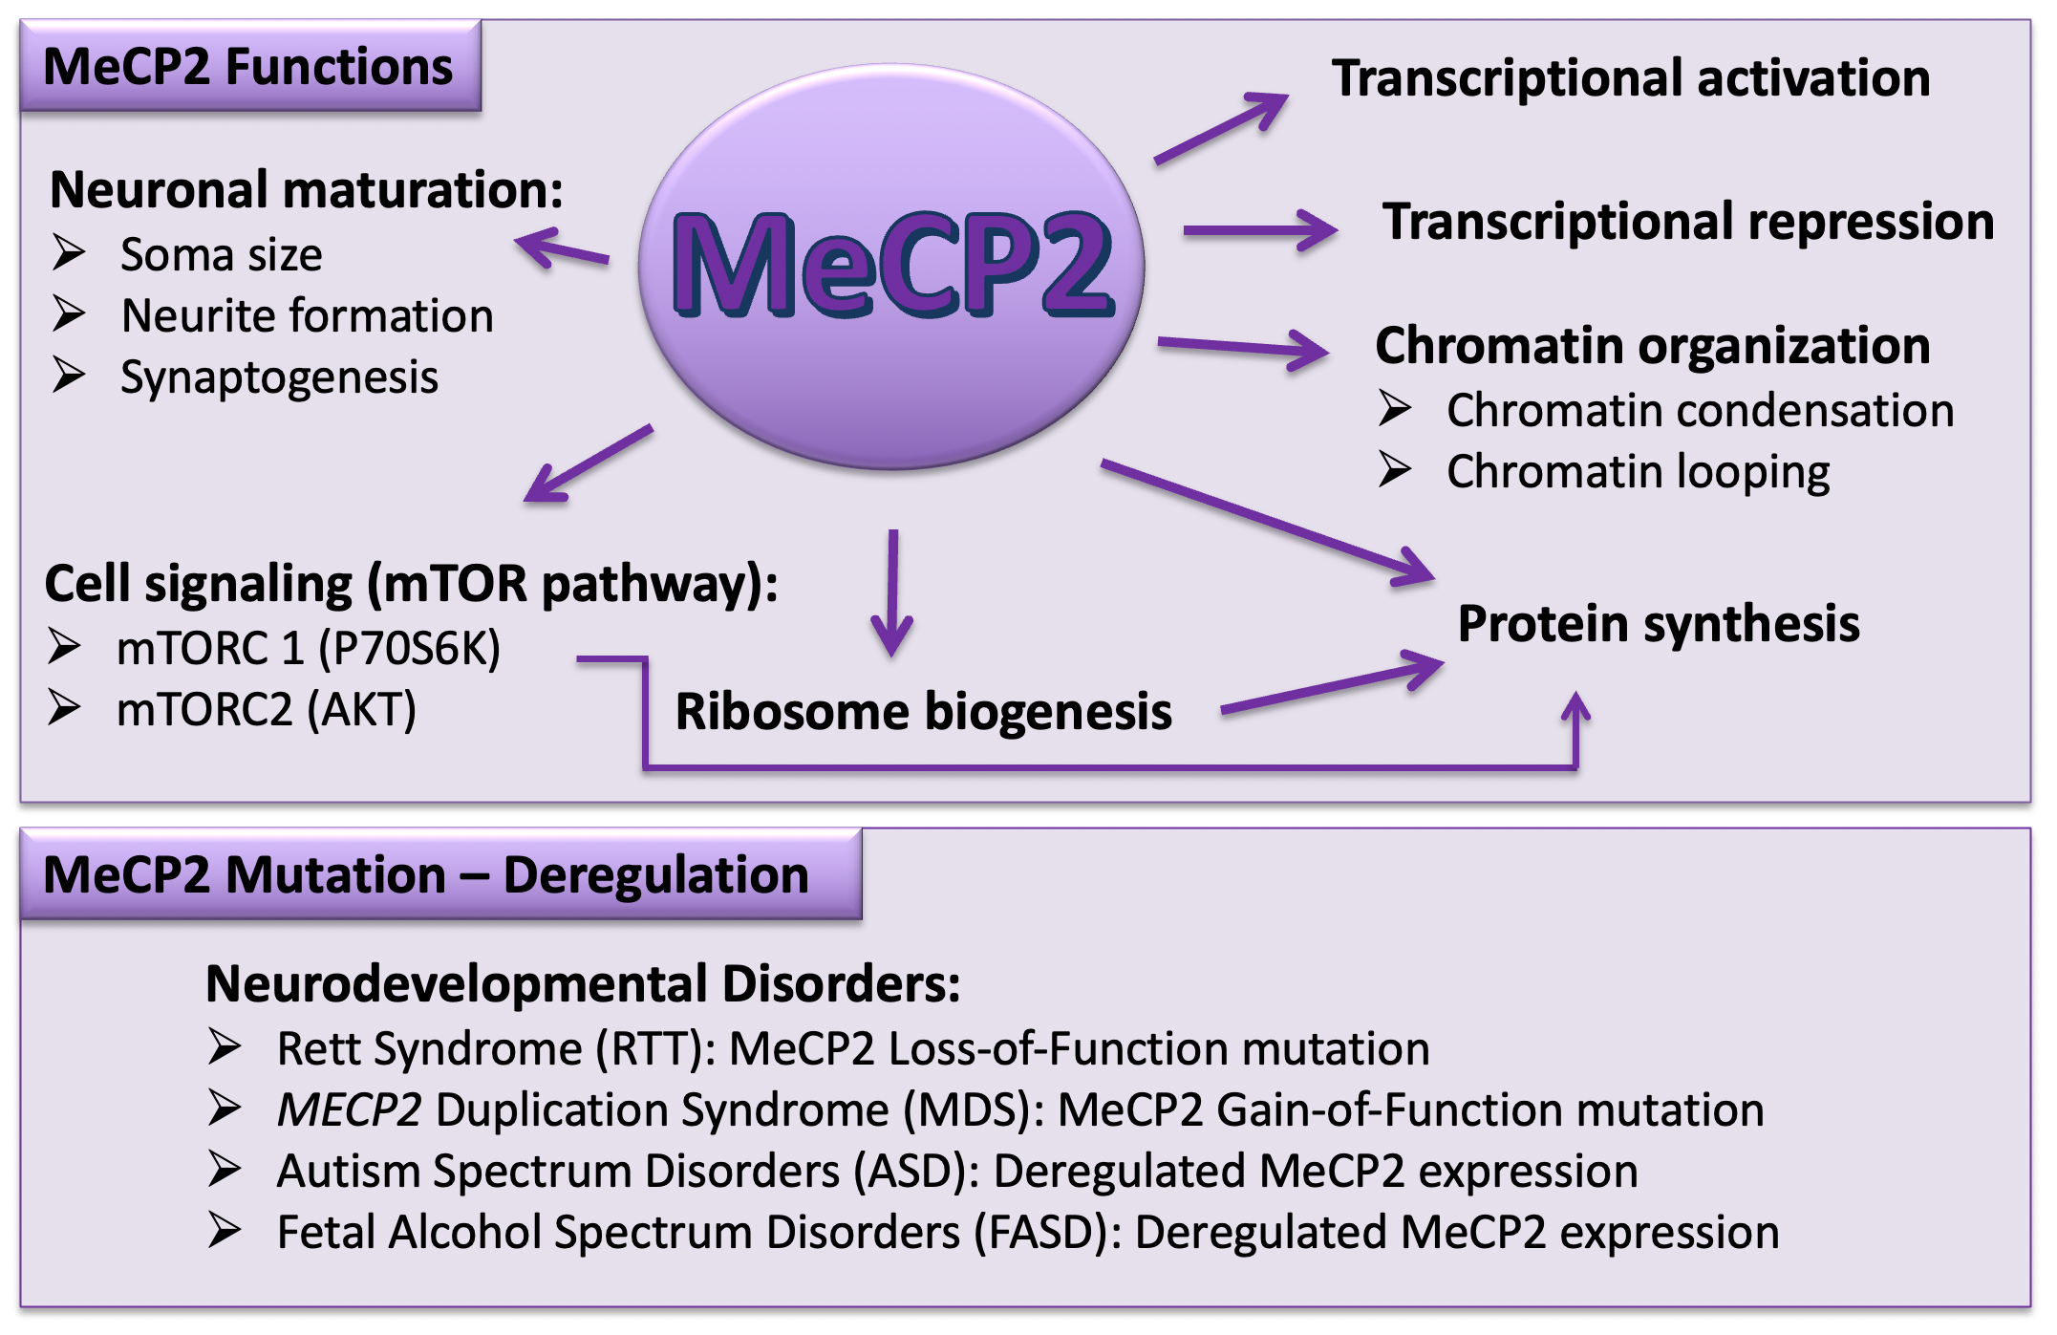
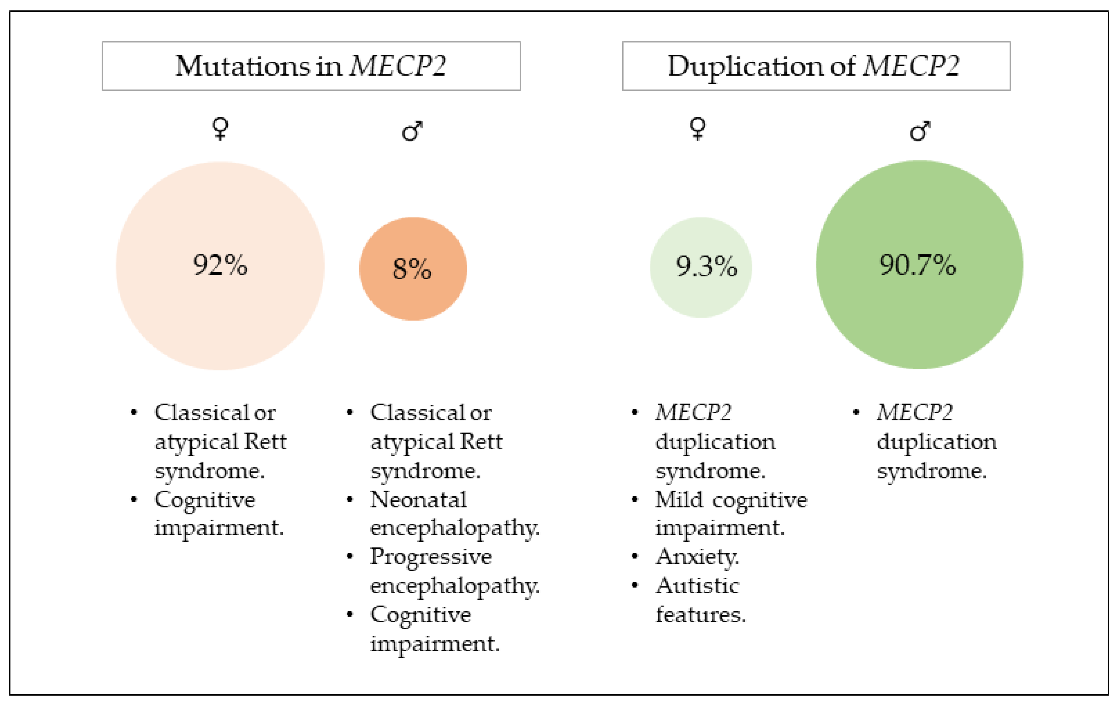
MECP2
What is known?
MECP2 mutations (methyl CpG binding protein 2) lead to Rett syndrome
Mecp2 is a transcription factor that functions mostly as a gene repressor by binding to methylated DNA at methyl-CpG sites
Mecp2 is located on the X chromosome, >90% Rett syndrome patients are females
Mecp2 duplication syndrome mostly affects males
A lot less is known about MECP2 duplication syndrome
Mecp2 duplication phenotype- Epilepsy (50%) difficult to treat GTCS, hypotonia and feeding difficulties in infancy, delayed motor skills, poor/absent speech, cognitive impairment, breathing abnormalities, chest infections
Rett syndrome and Mecp2 duplication syndrome gender repartition

Slide 3
CDKL5
What is known?
CDKL5 is one of the most common causes of genetic epilepsies
Early onset seizures- <3 months
The epilepsy frequently progresses to Infantile Spasms and epileptic encephalopathy.
The CDKL5 protein kinase involved in cytoplasm and the nucleus.
CDKL5 gene is located on the X chromosome, males are more severely affected than females.
Phenotype- Epilepsy, physical, development
Notes:
Severe early onset epilepsy

Slide 4
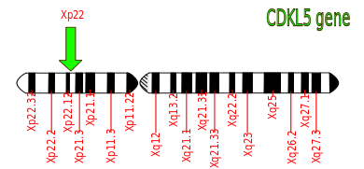
Aims of the study
Collect data on MECP2 and CDKL5 patients in the EoE region- phenotype, treatment and outcomes
Groundwork for potential clinical trial participation as a center
Early clinical signs
Management practices for MECP2-deficiency/duplication & CDKL5 deficiency children
Use and effectiveness of non-conventional treatment
Established Rett-causing mutations
Established CDKL5 mutations

Slide 5
-Early Infantile seizures? -Hypotonia and difficult to treat Seizures? > Do you have a genetic diagnosis? > Think CDKL5 and MECP2 duplication syndromes
We are looking to recruit patients with genetic diagnosis of Mecp2 related syndrome or CDKL5 deficiency
Contribute to the regional study to gather data on
Early clinical signs
Management practices for MECP2 & CDKL5 deficiency children
Use and effectiveness of non-conventional treatment
Under guidance of Cambridge university Hospital Paediatric neurology team
Dr Gautam Ambegaonkar, Dr Pooja Harijan,
Dr Nickolaos Cholidis
Please contact
For MECP2- Dr Asma Soltani- asma.soltani@nhs.net
For CDKL5- Dr Lipi Shekhar- lipi.Shekhar@nhs.net

