Slide 1
Early Childhood Epilepsies
A retrospective observational study of the Cambridgeshire special schools cohort
By Ellie Davis
Supervised by Dr Katie Burton

Slide 2
Definitions
Early developmental impairment:
Those children who already had a global developmental delay diagnosis on their medical records, or who had a diagnosed learning disability
Drug-resistant epilepsy (DRE):
“Ongoing epileptic seizures despite two adequately trialled and tolerated antiepileptic drug (AED) regimens, or the prescription of a third AED regimen due to lack of efficacy of two previous medications” (Symonds et al., 2021)
Learning disability:
Those who were functioning at less than half chronological age on clinical assessment

Slide 3
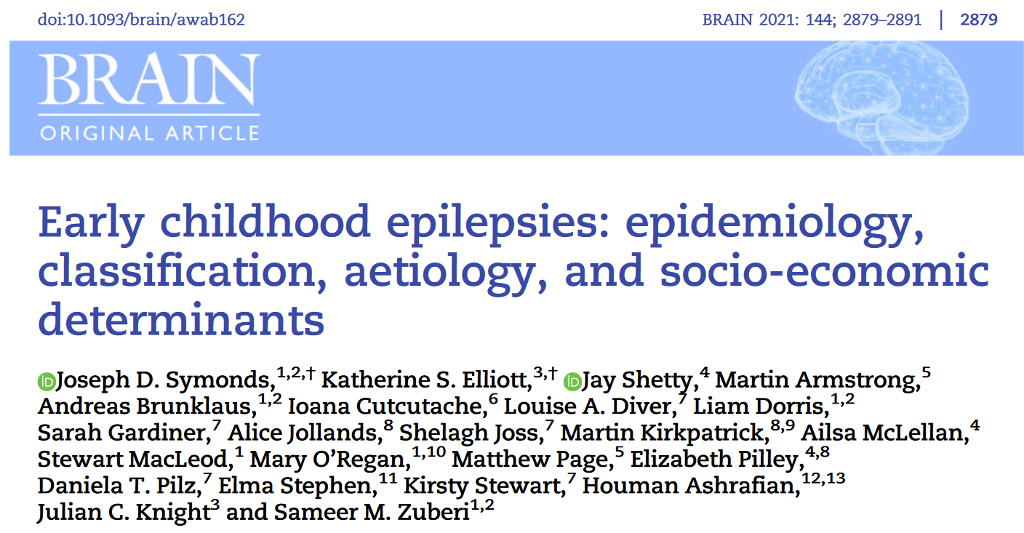
Symonds et al., 2019, 2021
Analysis of children born in Scotland in 2014-17 to assess the prevalence of epilepsy in under 3s
Identified the most common single-gene causes
Genetic testing was the highest yield investigation

Slide 4
Inclusion criteria
Presentation with at least two unprovoked seizures, or
Presentation with an episode of status epilepticus, or
2/+ prolonged febrile seizures
AND
Presentation before the child reached three years of age
Based on the inclusion criteria of Symond’s et al., 2021

Slide 5
Exclusion criteria
Neonatal seizures which resolved and no other unprovoked seizures occurred before the age of three;
Provoked seizures, including acute symptomatic seizures or febrile seizures.
Those whose epilepsy diagnosis was subsequently disproved
Patients without sufficient records on their early epilepsy (N=3)
Based on the inclusion criteria of Symond’s et al., 2021

Slide 6
Results

Slide 7
Phenotypes
30 patients (40%) met the inclusion criteria
15 had an identified genetic aetiology
Seven different epilepsy syndromes or complex conditions were recognised across 14 patients
Figure 1 - Age of child at first seizure

Slide 8
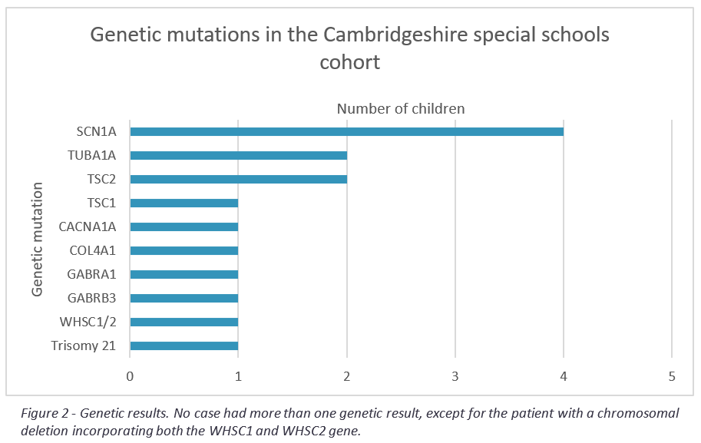
Notes:
Figure 2 - Genetic results. No case had more than one genetic result, except for the patient with a chromosomal deletion incorporating both the WHSC1 and WHSC2 gene.

Slide 9
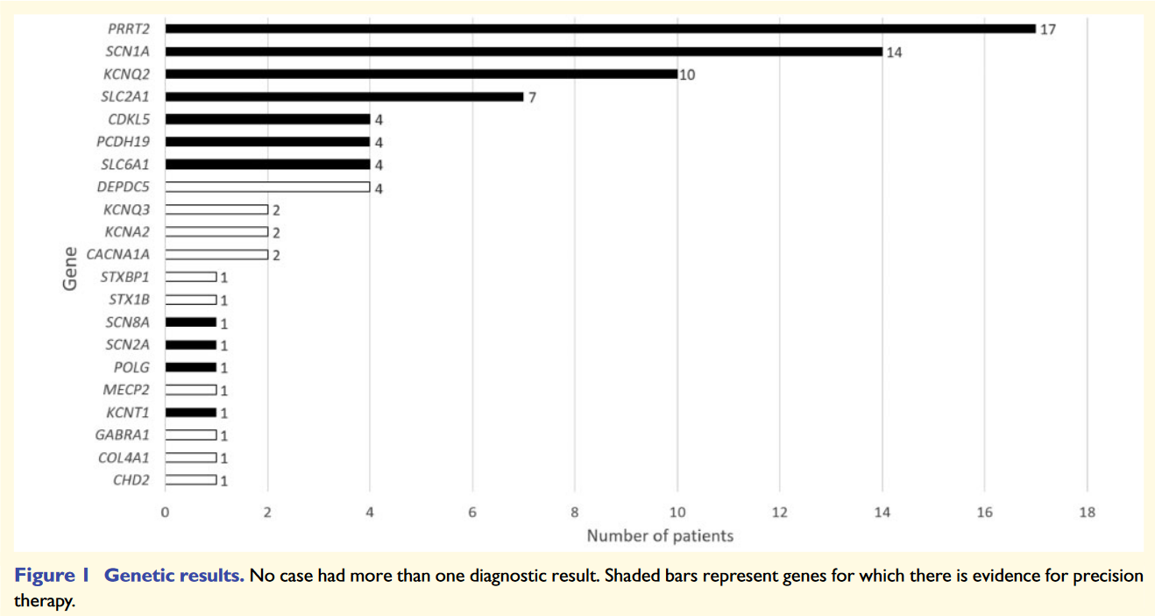
“Single-gene disorders accounted for a quarter of the seizure disorders in this cohort”
Symond’s et al., Brain (2019)
Notes:
Figure 2 - Genetic results. No case had more than one genetic result, except for the patient with a chromosomal deletion incorporating both the WHSC1 and WHSC2 gene.

Slide 10
Neurodevelopment and cognitive difficulties

Slide 11
Aetiology

Slide 12
Notes:
Figure 3 – Aetiologies of the whole cohort. Acquired brain injury encompasses: HIE, drowning episode, ischaemic and infectious causes.
Of the 30 patients included in this study, 20 (67%) have had at least one genetic test performed. 15 of these 20 (75%) were found to have a genetic aetiology explaining their epilepsy. Moreover, three of these 20 (15%) are considered very likely to have a genetic aetiology, but with no specific genetic cause found to date. These three patients would likely benefit from further genetic testing. Therefore, our results correlate with that of the larger Symond’s studies whereby “Genetic epilepsies comprise the largest aetiological group”
The proportion of genetic compared to other aetiologies is smaller in the whole cohort (50%) compared to those whose epilepsy presented before the age of 6 months (57%), as shown in the figure on the next slide (Figure 2).

Slide 13
Notes:
Figure 3 - Aetiologies in those with epilepsy presenting before 6 months of age. Acquired brain injury encompasses: HIE, drowning episode, ischaemic and infectious causes.

Slide 14
Types of genetic testing
Specific tests
Chromosomal microarrays
DDD study
SPEED study
GEMINI
COL4A gene panel
Exome sequencing
Etc.

Slide 15
Acquired brain injuries
HIE
Drowning episode
GBS meningitis / meningoencephalitis

Slide 16
Therapies and responses

Slide 17
Notes:
Figure 4 –Current number of AEDs being taken by each child, separated by the age at which they first presented with epilepsy.

Slide 18
Notes:
Figure 4 – Top panel = current number of AEDs being taken by each child, separated by the age at which they first presented with epilepsy. Bottom panel = total number of AEDs trialled over each child’s lifetime, separated by the age at which they first presented with epilepsy.

Slide 19
Other therapeutic options
VNS
Epilepsy surgery
Cannabidiol
Ketogenic diet
Notes:
Other therapeutic options trialled are listed above.

Slide 20
Disease burden
No. of ED visits in the last 12 months
No. of hospital clinic appointments in the last 12 months
Phone calls with the epilepsy specialist nurse

Slide 21
Conclusions
Genetic aetiology was more prevalent in our cohort than in previous cohorts
Genetic aetiology was greatest at earliest presentation
Support for the new NICE guidelines for early epilepsy
Review of children with epilepsy at older age is advisable
Early onset epilepsies can have a profound negative impact on development
Understanding the genetic mutations underlying the most severe outcomes can help to guide management and inform new research into precision medicine

Slide 22
Any Questions?

Slide 23
Appendix

Slide 24
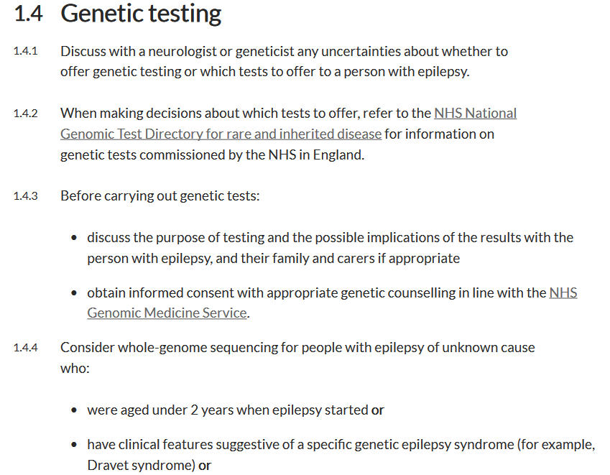
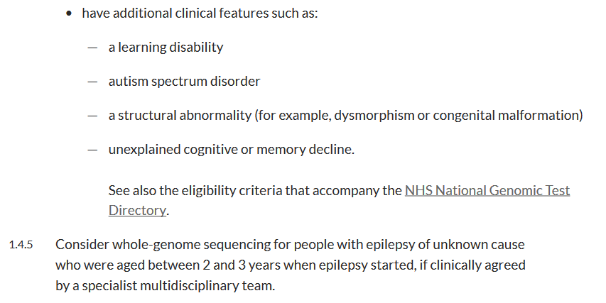

Slide 25
Notes:
Figure 5 - Age-adjusted total number of AEDs taken in a child's lifetime

