Slide 1
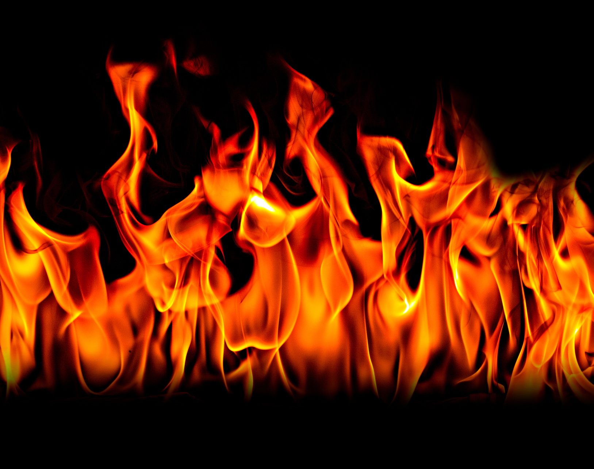
Febrile infection-related epilepsy syndrome (FIRES)
Dr Thiloka Ratnaike
(ST5 Paediatrics registrar, Colchester Hospital)

Slide 2
Background
Predisposed patient (?allelic variations in cytokine pathways)
Nonspecific infection
Reduced seizure threshold
Further uncontrolled CNS inflammatory response +/- mitochondrial dysfunction/synaptic plasticity
Inflammatory cascade (could take days)
Refractory seizures²
Subcategory of NORSE: New Onset Refractory Status Epilepticus
Clinical presentation in a patient without active epilepsy or pre-existing neurological disorders, without a clear acute/structural/toxic/metabolic cause¹
>1300 patients described
FIRES diagnosis requires:
Febrile illness starting 24 hours to 2 weeks before onset of RSE
Applies to all age groups¹, slight male predominance, median age at onset ~8y², prior normal development
¹International consensus recommendations for management of new onset refractory status epilepticus (NORSE) including febrile infection-related epilepsy syndrome (FIRES): Summary and clinical tools (2022)
²New-onset refractory status epilepticus (NORSE) and febrile infection–related epilepsy syndrome (FIRES): State of the art and perspectives (2018)
Notes:
https://onlinelibrary.wiley.com/doi/10.1111/epi.17391
https://onlinelibrary.wiley.com/doi/10.1002/epi4.12447
Prodromal phase 1-14 days prior to seizure onset.Prodromal symptoms include confusion, fatigue, headache, recent mild febrile illness, behavioural changes, and memory symptoms.Fever may be low grade or absent, cessation of fever in about 50% patients prior to seizures
Immune inflammatory mediated epileptic encephalopathy
Intrathecal overproduction of pro inflammatory cytokines and chemokine with proconvulsive activity
Play between pro and anti inflammatory molecules results in delay of the onset of seizures from insult ( infection)
Additional factors like mitochondrial dysfunction adds to RSE
Factors- TNF,IL6,CXCL1,9,10,11,CCL 19
Functional and genetic defect in IL 1 pathway
A unifying mechanism that could account for the all the specific features of cryptogenic NORSE and FIRES is still lacking. It is, however, tempting to speculate that it might be caused by a fulminant inflammatory response in the CNS.25 An intrathecal overproduction of proinflammatory cytokines and chemokines has been described in children with FIRES, and was not observed in the CSF of controls with other inflammatory and non-inflammatory neurological conditions.26 Several of these molecules have proconvulsant activity. This accumulation could be the product of the activation of T cells, perivascular cells, and glia and could take several days, perhaps explaining the latency between the febrile episode and the onset of SE. However, it is currently unclear whether intrathecal inflammation is the cause or the consequence of the prolonged episode of refractory SE (RSE), as controls with RSE of noninflammatory origin were not studied. Furthermore, whether this cytokine storm is sufficient to explain a long-lasting severe episode of SE is also unclear, and additional mechanisms such as mitochondrial dysfunction or synaptic plasticity may occur.

Slide 3
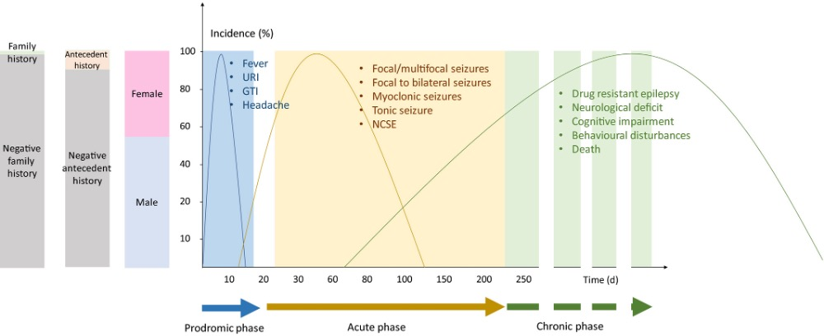
N Specchio, N and Pietrafusa, N; (2020). New-onset refractory status epilepticus and febrile infection-related epilepsy syndrome (2020)
Notes:
Patients with FIRES share common clinical characteristics, they are: previously typically developing children or adults presenting with a prodromal phase (usually a febrile illness, such as minor upper respiratory tract infection or gastroenteritis) 1 to 14 days before seizure onset and status epilepticus.²⁰ During the infectious illness, fever may be low grade (median duration of 4d) or even absent, and fever cessation occurs at the time of first seizure in about half of patients.²⁰
Prodromal symptoms also precede the onset of NORSE in 60% of patients, and include confusion, fatigue, headache, recent mild febrile illness, behavioural changes, and memory symptoms.^{5, 8, 22}
After onset, seizure frequency increases rapidly, or seizures tend to worsen to RSE. Children with FIRES commonly have hundreds of seizures each day during the acute phase. In adults, seizures are focal motor with preserved awareness and facial twitching or with impaired awareness and lateral deviation of the head, chewing movements, and autonomic features, suggesting a mesial temporal lobe involvement, and a strong tendency to bilateral tonic-clonic seizures. Myoclonic seizures of facial and oro-buccal muscles may also be present. Consciousness is decreased, including during the interictal period. The duration of the acute phase is variable – lasting from a few days to several months. Usually, seizures are the main manifestation during the acute phase of illness.^{13, 15, 20, 24}
The clinical course is typically biphasic, with no silent period between the two phases: an initial acute catastrophic phase followed by a chronic phase with refractory epilepsy and neurological impairment

