Slide 1
Epilepsy Clinic Templates
Wael Elsayed

Slide 2
Structered and organised
informative
time saving
Better communication
Meets guidelines
……….

Slide 3
15 Responses / 12 Hospitals

Slide 4
Do you think it is a good idea to have a letter template for epilepsy clinics in EOE?

Slide 5
Do you use a letter template for Epilepsy clinic ?

Slide 6
Do you use a template letter for the referral of children with epilepsy?

Slide 7
Comments
Curious to see what other people use.
Please create one in keeping with epilepsy 12 data needed.
Each child is different, but I suppose if we have template regarding diagnosis based on ILAE classification, it will be useful
allow for clinical narrative in the new template

Slide 8
Dr. Brown
Description of episodes:
Seizure type: (Epileptic/non-epileptic)
Syndrome:
Genetic/Acquired:
Relevant Impairment:
Investigations:
EEG
MRI
ECG
Bloods
Pending investigations:
Previous Medication(s): dates/reason stopped
Current medication(s):

Slide 10
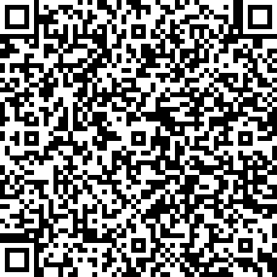

Slide 11
Adoption of the ILAE multiaxial classification into regional clinic letters as recommended by NICE and the BPNA PET courses
Adoption of standard, brief documentation of key Epilepsy12 metrics which will be high priority areas for quality improvement as part of the NHS England Transformation plan as documentation of valproate discussion in young women, mental health screening, documentation of SUDEP discussion, transition plan, care plan etc.

Slide 12
What do you think?

